Slide 1
BHAGYANAGARAM
BY
G.EMMANUEL NISCHAY & P.KIRAN

Slide 2
WEBSITE
COLLECTION OF WEB PAGES.
CAN BE ACCESSED USING A BROWSER.
CONTAINS VARIOUS TYPES OF MEDIA.
IT CAN BE STATIC AND DYNAMIC.
STATIC WEBSITE : DOES NOT CONTAIN DYNAMIC OR INTERACTIVE FEATURES.
DYNAMIC WEBSITE : IT HAS INTERACTIVE FEATURES THAT ALLOWS USERS TO ENGAGE WITH THE SITE.

Slide 3
HARDWARE REQUIREMENTS
Operating System : Windows 8 or later
Processor : Intel Pentium 4 or later
Memory : 2GB minimum, 4GB recommended
Internet Requirement : Required

Slide 4
SOFTWARE REQUIREMENT
CODE EDITOR (Visual studio code)
Web Browser
XAMPP Server

Slide 5
ABSTRACT
THE MAIN IDEA OF THE PROJECT IS TO PROJECT A GATHERED INFORMATION ABOUT THE PLACES.
THE USERS WHEN VISIT A WEBSITE, INFORMTION AND ITS LOCATION IS WHAT USERS LOOK INTO.
THE AIM OF THE PROJECT IS TO GIVE THE DIRCTIONS OF THE PLACES TO THE USERS WITHIN THE WEB PAGE.
IN MOST OF THE CASES WHEN FRIENDS TRY TO GO TO A PLACE, THEY WILL NOT BE AWARE OF THE DIRECTIONS, SO THE DIRECTIONS BUTTON BELOW THE PLACE INFORMATION MAKES IT EASIER TO SEE THE DIRECTIONS WITHIN THE PAGE.
THIS AVOIDS THE SEARCHING FOR THE DIRECTIONS OF THE PLACE IN MAPS.

Slide 6
DIFFERENCES
OUR WEBSITE
OTHER WEBSITES
RESPONSIVE HOMEPAGE.
COMPLETE INFORMATION IS GROUPED TOGETHER.
WE HAVE DIRECTIONS BUTTON GIVEN FOR EACH PLACE.
THERE IS NO NEED TO SEARCH FOR DIRECTIONS.
HOMEPAGE IS NOT RESPONSIVE.
INFORMATION IS NOT TOGETHER.
THERE IS NO DIRECTIONS GIVEN.
WE NEED TO SEARCH FOR DIRECTIONS OF THE PLACE.

Slide 7
UML DIAGRAMS
DEVELOPMENT MODELING LANGUAGE.
USED TO SPECIFY,VISUALIZE, MODIFY, CONSTRUCT AND DOCUMENT THE COMPONENTS.
IT CAN BE USED FOR ANY PROCESS, THROUGHOUT THE SOFTWARE DEVELOPMENT LIFECYCLE.

Slide 8
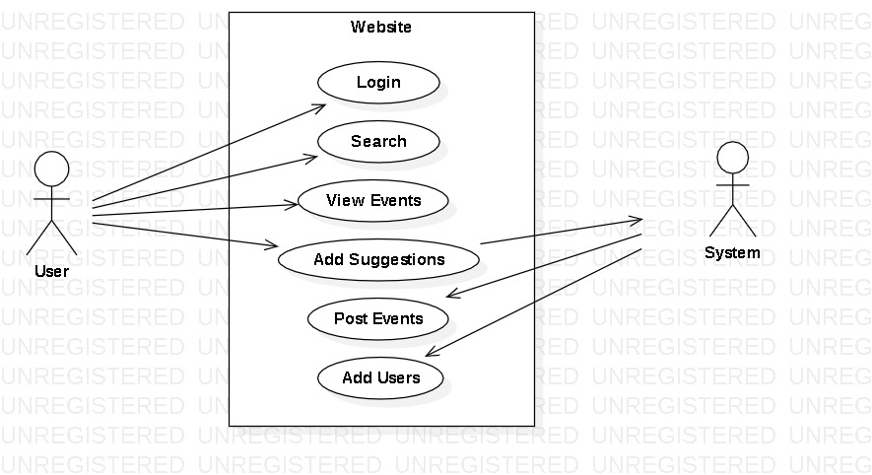
USE CASE DIAGRAM

Slide 9
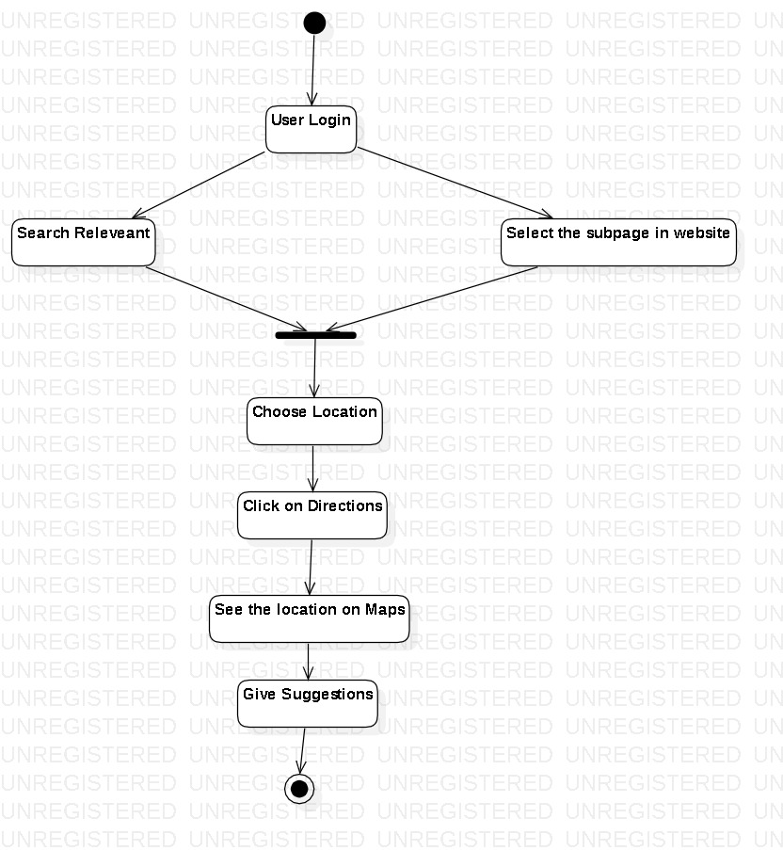
ACTIVITY DIAGRAM

Slide 10
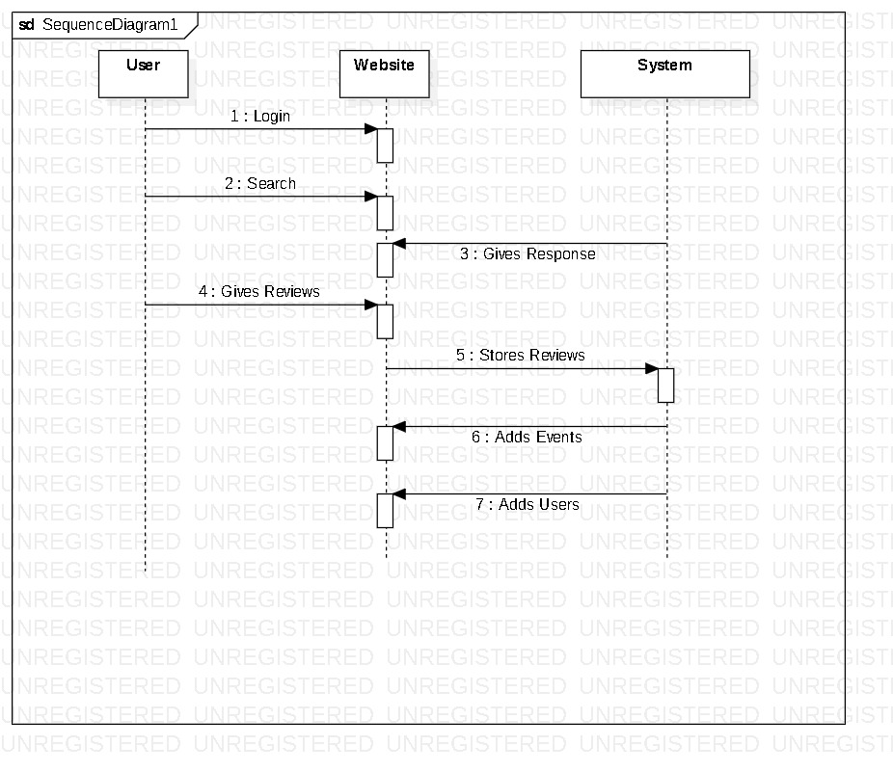
SEQUENCE DIAGRAM

Slide 11
OUTPUT OF THE PROJECT

Slide 12
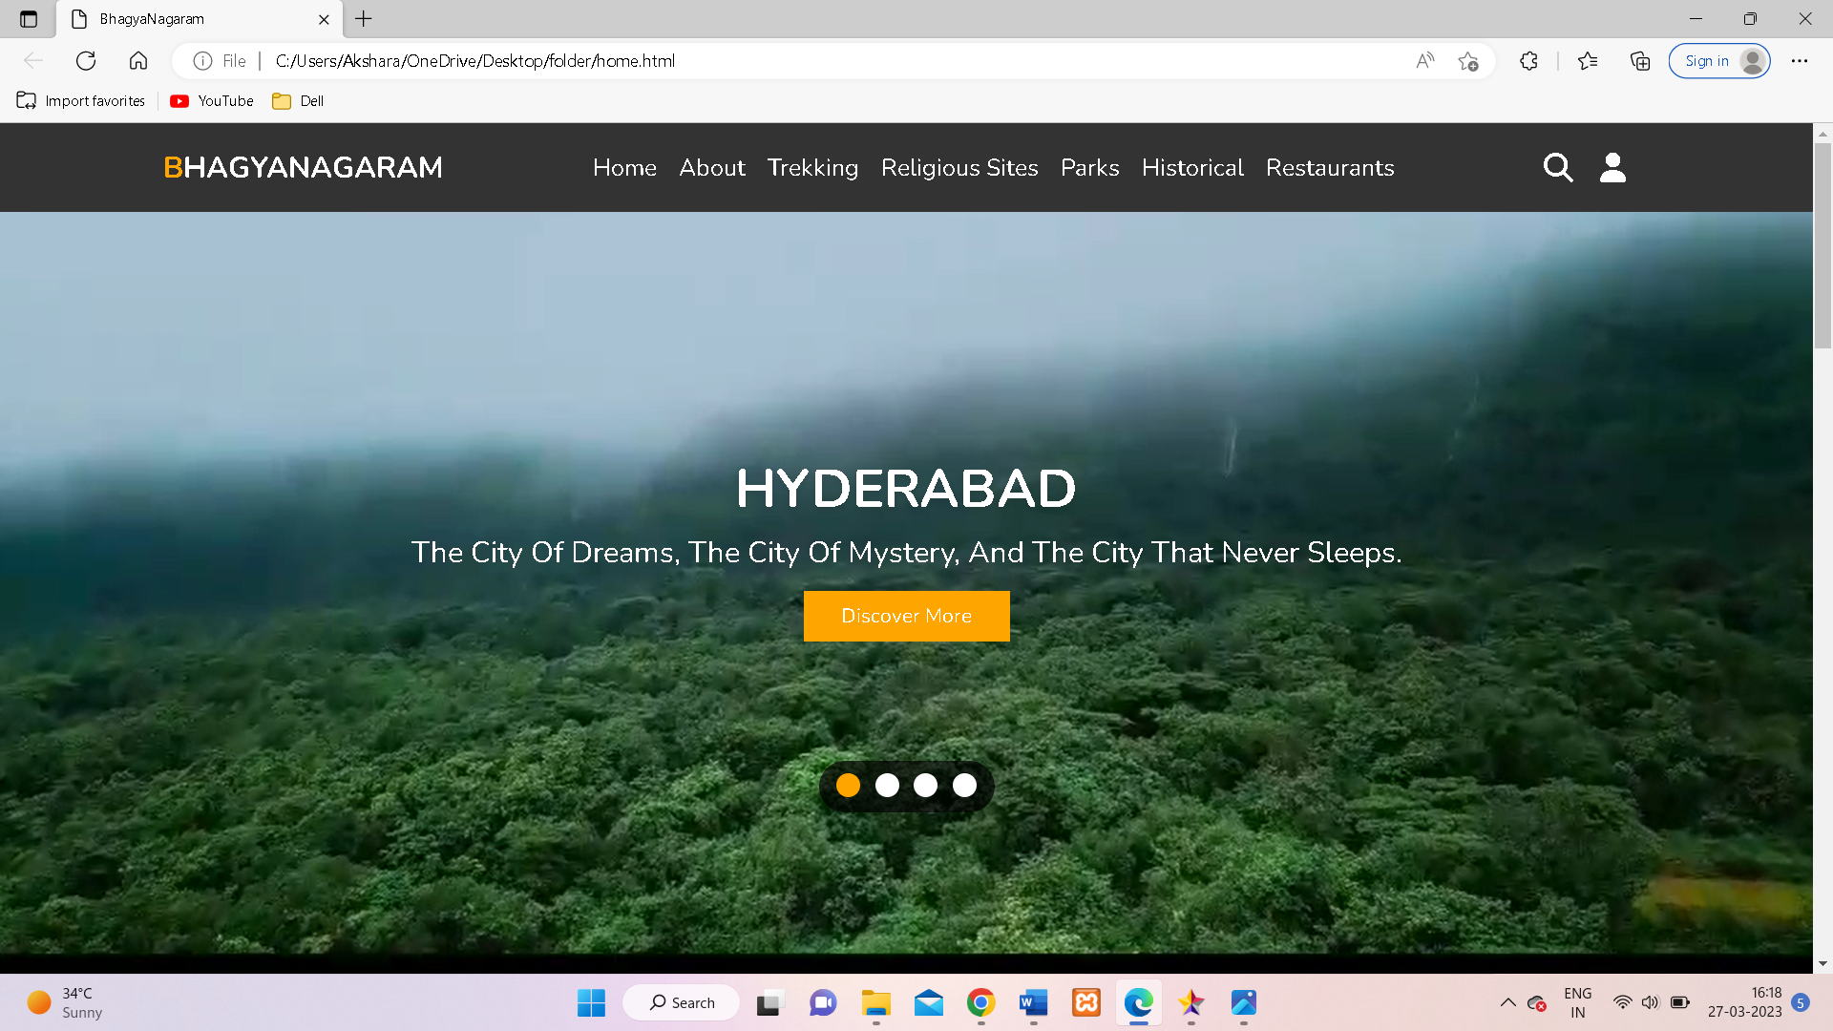

Slide 13
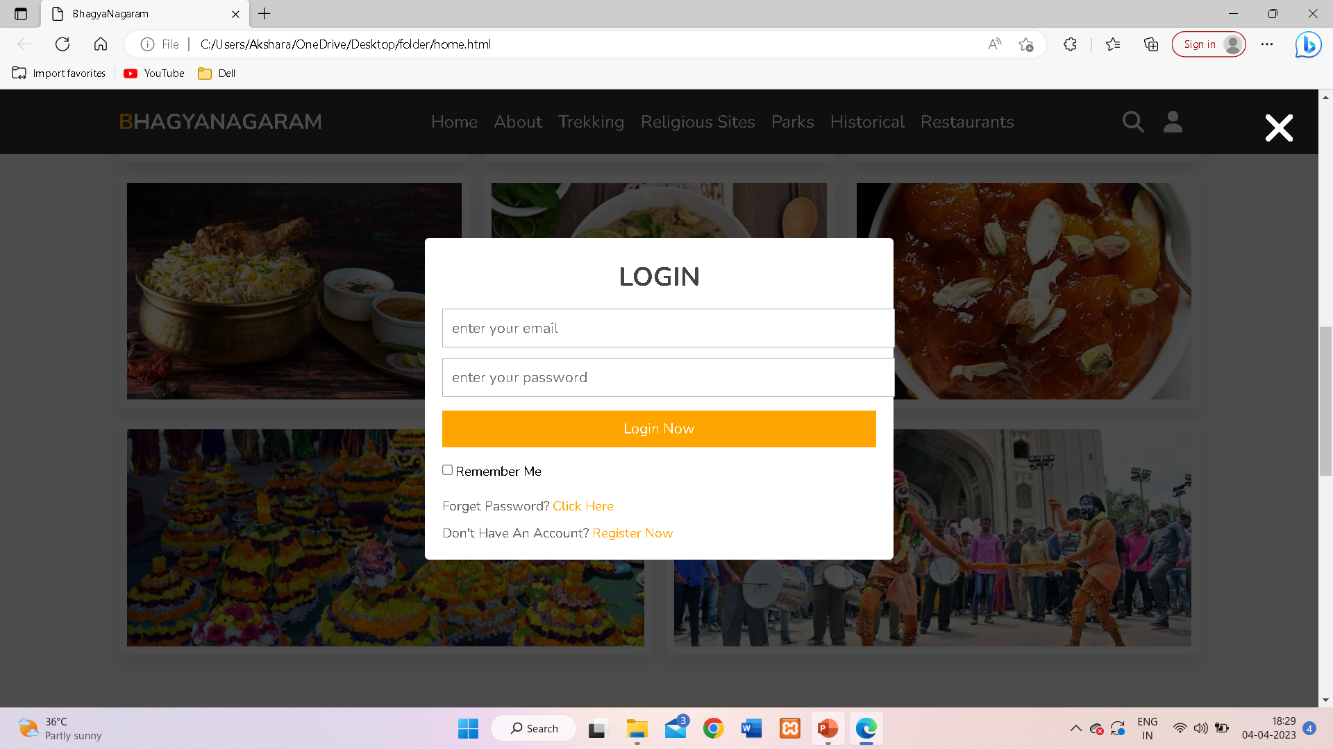

Slide 14
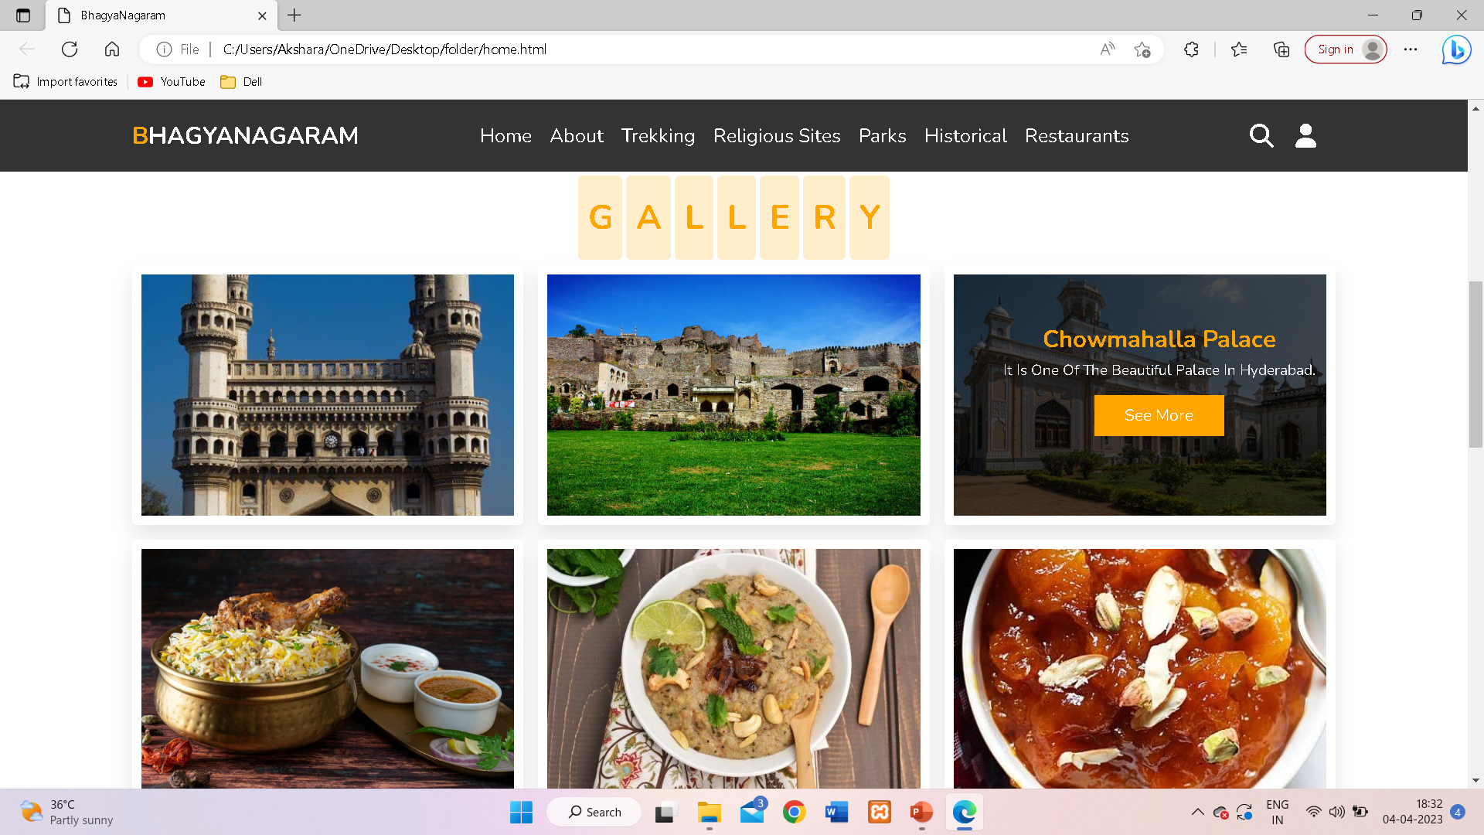

Slide 15
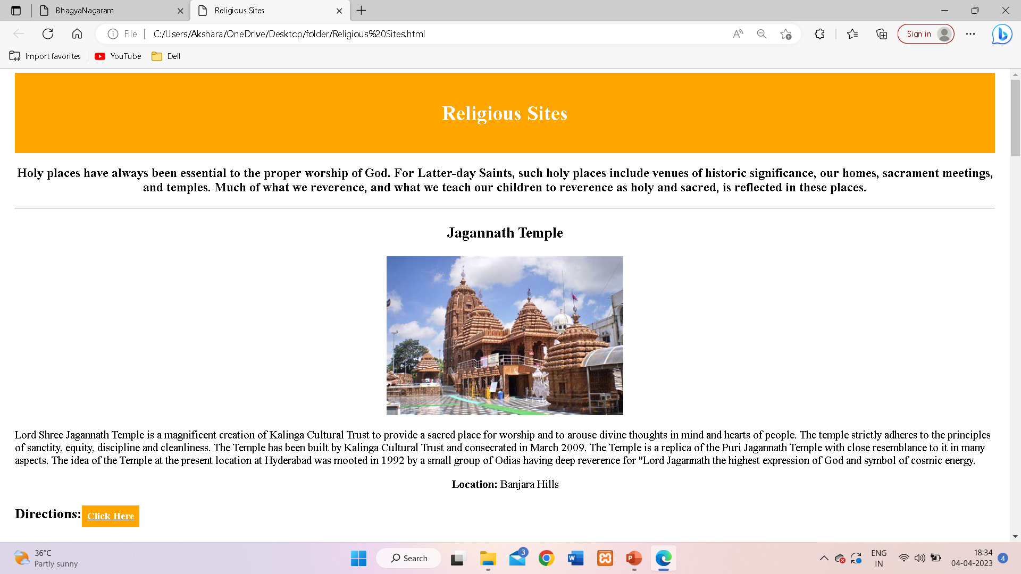

Slide 16
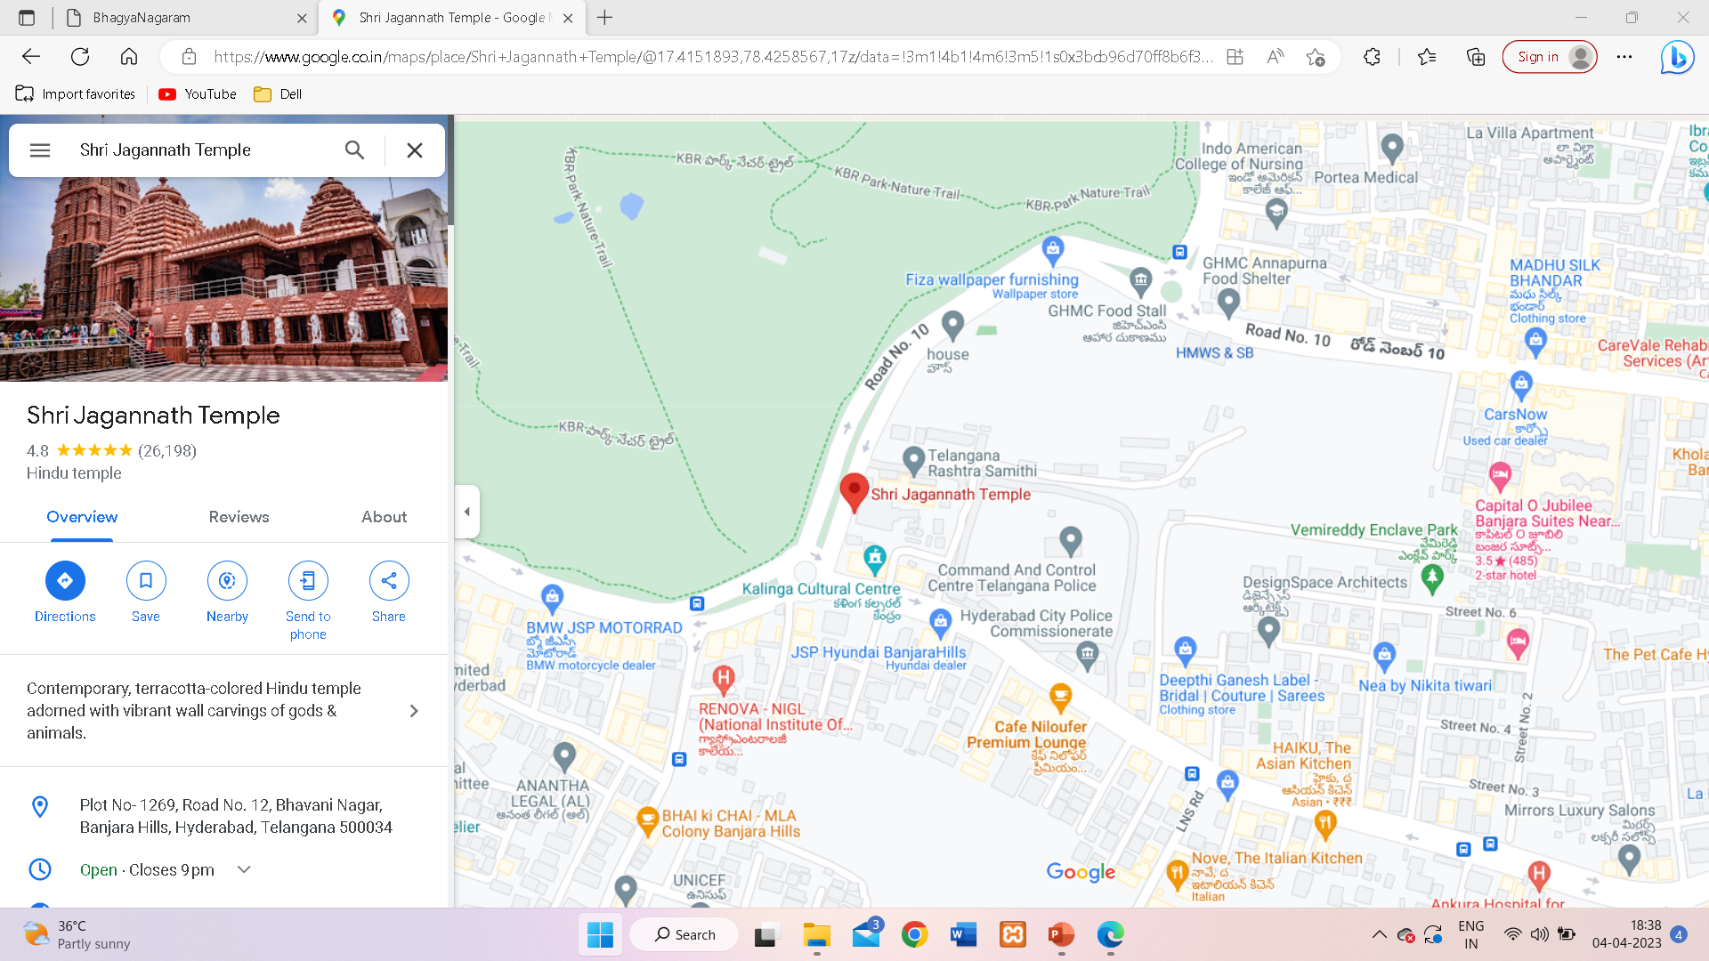

Slide 17
FUTURE SCOPE
WE CAN ADD OTHER STATE DETAILS TOO.
TO ADD OTHER STATES, WE NEED TO INCLUDE THE DETAILS OF TRAVELLING MORE INFORMTIVELY.
TO AVOID OUR WEBSITE FROM BECOMING CLUTTERED, WE NEED TO BE MORE SELECTIVE WITH PLACES WE PUT IN.
THERE WILL BE NO NEED OF A GUIDE, IF THIS WEBSITE IS INFORMATED PROPERLY.

Slide 18

THANK YOU
This Photo by Unknown Author is licensed under CC BY-NC-ND

